Slide 1
CS174A Lecture 5

Slide 2
Announcements & Reminders
2/04/24: A2 due; will be discussed during this week’s TA session
2/08/24: Midterm Exam: 6:00-7:30 PM PST, in person, in class
2/25/24: A3 due
Start forming your project teams (team size: 2-4)
2/28/24: initial project proposals & teams due
3/13/24: final proposals due

Slide 3
Last Lecture Recap
Interpolations: linear, affine, convex & their properties
Homogeneous representation of points & vectors
Shapes: lines, circles, polygons (triangles)
3D Polyhedrons: indexed data structure

Slide 4
Next Up
Team Project Intro
Transformations:
translations, rotations, scaling, shear
Matrix representations
Inverse of these transformations
Spaces:
Model space
Object/world space
Eye/camera space
Screen space

Slide 5
SIGGRAPH trailers from 2015
Going backwards,
https://www.youtube.com/watch?v=RvXtjANeujA
And
https://www.youtube.com/watch?v=XrYkEhs2FdA

Slide 6
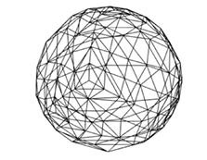
Polygons
An ordered sequence of vertices
Simple vs. Complex
Issue with Complex: hard to deal with self-intersecting polygons
Convex vs. Concave
Issue with Concave: point-inside-polygon test will fail in some cases
Issue with Concave: normal will point in wrong direction at concave vertices
Planar vs. Non-Planar
Issue with Non-Planar: normal are different at different locations on the non-planar face
Tessellation (any poly) vs. Triangulation (only triangles)

Slide 7
Why Triangles?
Ordered list of 3 non-collinear vertices
They are simple
They are planar
They are convex
Modern GPUs: several billion/sec, mobile: 100-200M triangles/sec
Shading, lighting, texture mapping all in GPU
WebGL uses triangles only for rendering

Slide 8
What do we do with our point lists?
Immediate mode rendering: Send them one at a time to GPU to draw every point of every triangle. Bad
Retained mode: Store them all in a data structure
Now we can store one matrix to represent the whole shape’s movement/positioning, instead of repeating ourselves on the point-by-point level
Can draw the same shape in many places this way
Better yet: Load the data onto the GPU once and re-use it there
Fewer slow GPU communications

Slide 9
Matrix Intro
Types of matrices found in graphics

Slide 10

What does a matrix mean?
A system of (first order) equations
Our mathematical tool to tweak 3D functions or point clouds with
Remember that a matrix is shorthand:

Slide 11
Reminder: Matrix Multiplication
A * B = M
Each cell of M is going to be a dot product of one row of A and one column of B.
Remember the rule:
Row size comes from A, column size comes from B
If B is just a vector (1 column), that’s fine, M will be too

Slide 12
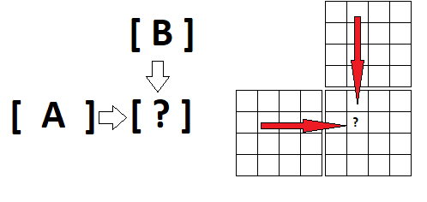
Reminder: Matrix Multiplication
It’s helpful to line up A and B offset when you write them down

Slide 13
Matrix Concepts
In Graphics: Guiding a shape into place in a scene
A few common graphics matrices perform movement, or “warp” space
What kind? Recall elementary row operations

Slide 14
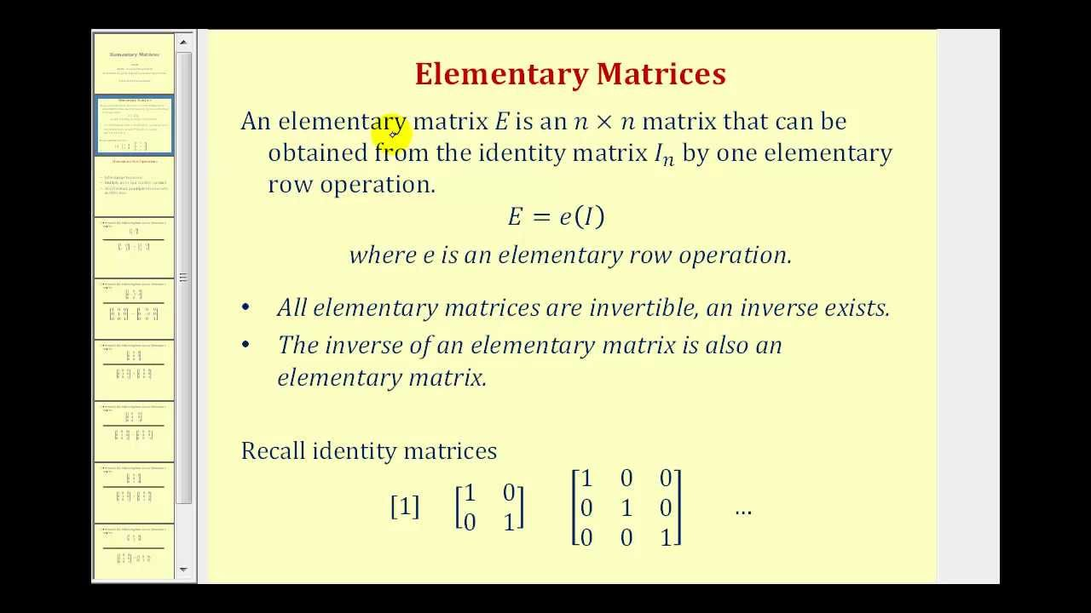

Slide 15
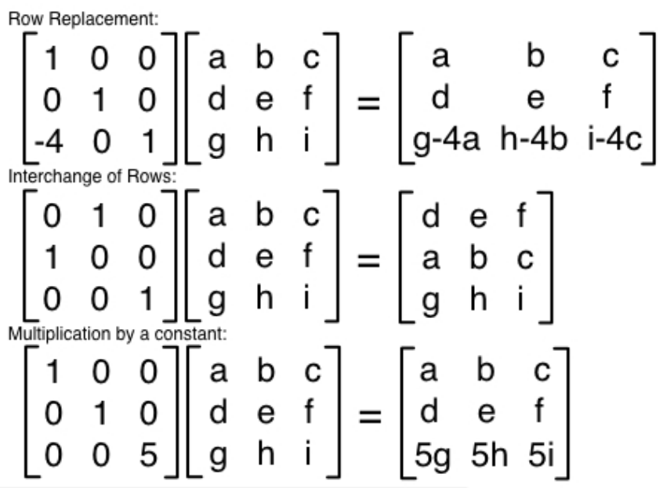

Slide 16
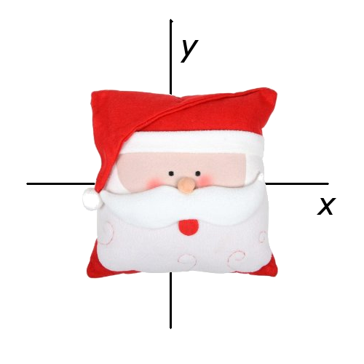
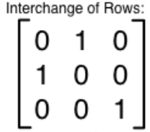

What if we apply e₁ to all the points of an image?

Slide 17
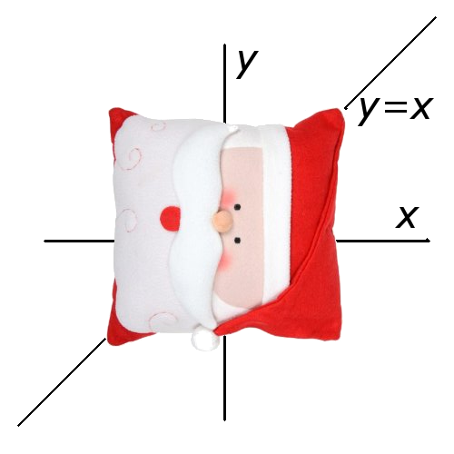
What if we apply e₁ to all the points of an image?
Our axes swap
new_{x}=y, new_{y}=x
Matrix form of that:

Slide 18
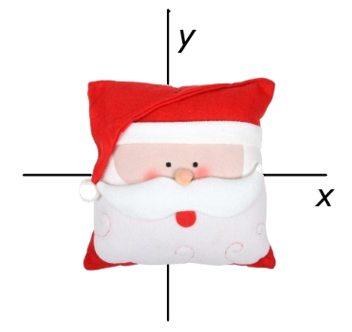
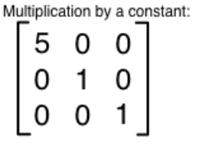
What if we apply e₂ to all the points of an image?

Slide 19
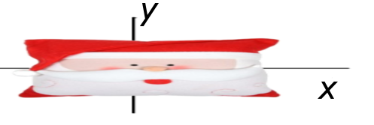
What if we apply e₂ to all the points of an image?
We get a scale.
new_{x}= 5x
Matrix form of that:

Slide 20
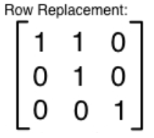
What if we apply e₃ to all the points of an image?

Slide 21
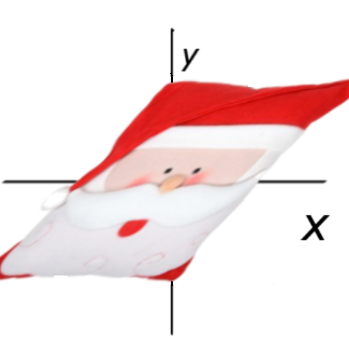
What if we apply e₃ to all the points of an image?
We get a “shear.”
new_{x}= x + y
Matrix form of that:

Slide 22

Rotation Matrices
A rotation is two shears.
But certain properties have to hold. This one is not a pure rotation matrix (it has some scaling effect too). Rotations have to have determinant = 1.

Slide 23

Rotation Matrices
A rotation also has to have orthogonal columns. This one passes that!
Our simpler shear matrix from earlier did not (check the columns):

Slide 24

Rotation Matrices
This one is more like it. Trig identities ensure this matrix always has determinant=1. The two columns are also always perpendicular. Suppose theta is 45 degrees:

Slide 25

Rotation Matrices
This one is more like it. Trig identities ensure this matrix always has determinant=1. The two columns are also always perpendicular. Suppose theta is 45 degrees:

Slide 26

Rotation Matrices
Let’s try our rotation matrix, but we don’t want to multiply ugly radicals so let’s combine it with a scale matrix for testing.
There, much better to work with. (This was our matrix from earlier that had a scaling influence).

Slide 27
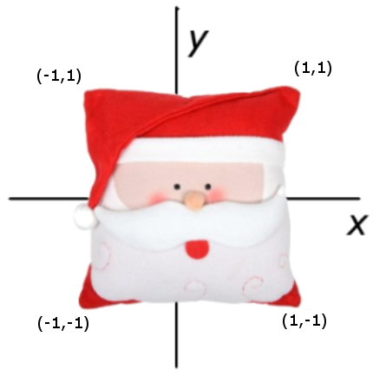

Rotation Matrices
What it means:

Slide 28
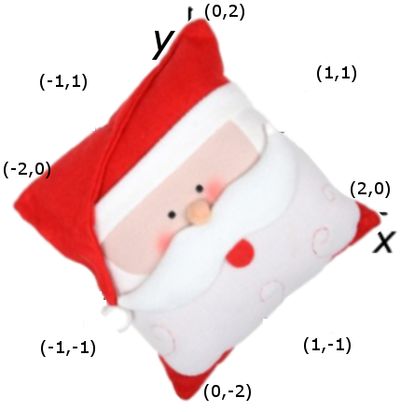
Rotation Matrices
What it means:

Slide 29
All this time...
SANTA’S NOSE HAS NEVER LEFT THE ORIGIN (!!!)
None of these operations have resulted in translation (sliding all of the points at once somewhere else)

Slide 30
Translation Matrices
Every matrix we’ve discovered using the elementary ones only has a linear effect, stretching and warping the image around the origin
Why can’t we accomplish translation of Santa to other places with our current machinery?

Slide 31
Translation Matrices
Every point always takes a contribution of x_{old}, y_{old}, and z_{old} to get its value
The origin point (0,0,0) will always contribute zero to each axis for the new point, mapping onto itself.
We need to be able to take a component of some other quantity besides x_{old}, y_{old}, and z_{old}
Our vector we’re multiplying needs to grow by 1 term.
Let’s supply an extra constant. Use 1.

Slide 32

Translation Matrices
Solution:
One of the components that contributes to the answer is now the constant 1, which we can pull from even when all others are zero. This allows us to move the picture.

Slide 33
Translation Matrices
We’d like our new vector to have “1” in the 4th coordinate as well, so we can use matrices on it right away.
What does our matrix have to be like to ensure that will happen?

Slide 34

Translation Matrices
Solution:
This 4th row is an equation that literally says “1_{new}=1_{old}”.

Slide 35
Linear Vs. Affine Transformations
A linear transformation only takes linear combinations of x, y, and z.
Santa’s nose stays on the origin forever.
An *affine* transformation is more general and more powerful.
It’s called an affine transformation because it preserves affine combinations (line segment interpolations don’t get messed up before vs. after).

Slide 36

Translation Matrices
3D translations are the reason we use 4x4 matrices instead of 3x3.
Let’s do one:

Slide 37
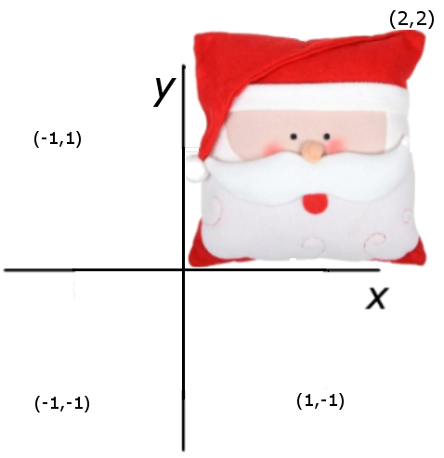
Translation Matrices
3D translations are the reason we use 4x4 matrices instead of 3x3.
Let’s do one:

Slide 38
Summary: Affine is Useful
Affine transformations are the main modeling tool in graphics
They are applied as matrix multiplications
Any affine transformation can be performed as a series of elementary affine transformations
We can now do object placement
Model entire scenes

Slide 39
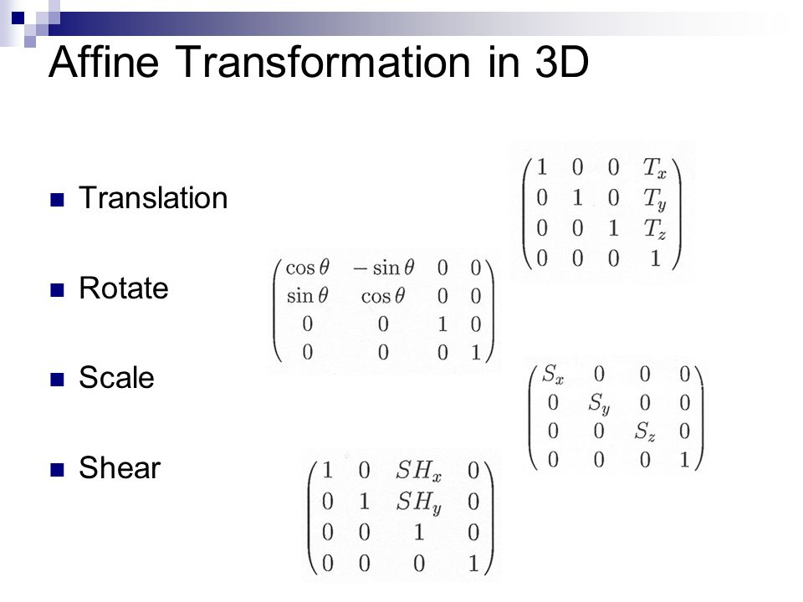
Summary of Affine Transformations

Slide 40
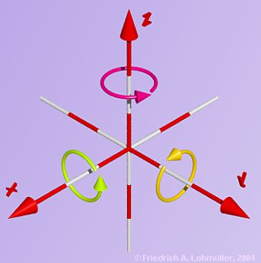
Three Axes to Rotate Around

Slide 41
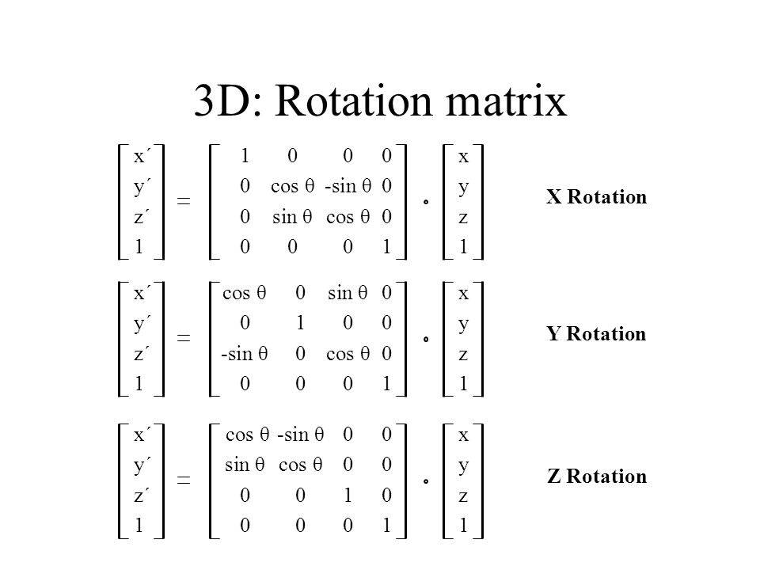
Rotation Matrices

Slide 42
3D Rotation
Various representations possible
Decomposition into axis rotations
x-roll, y-roll, z-roll
Counterclockwise positive angle assumption

Slide 43
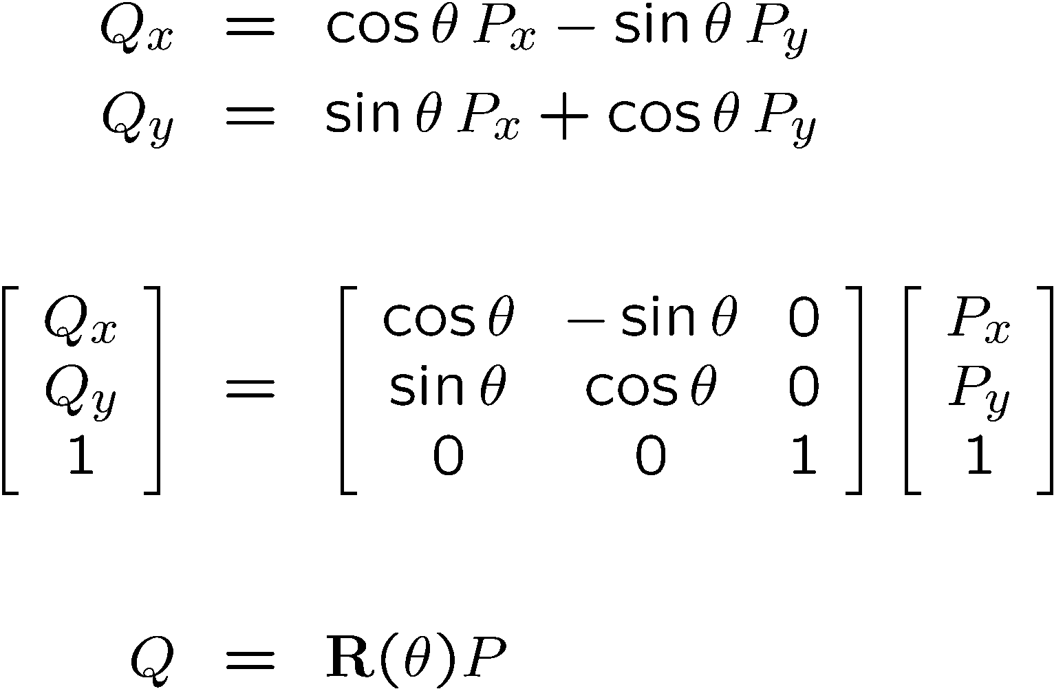
Reminder: 2D Rotation
In matrix form:
Or:

Slide 44
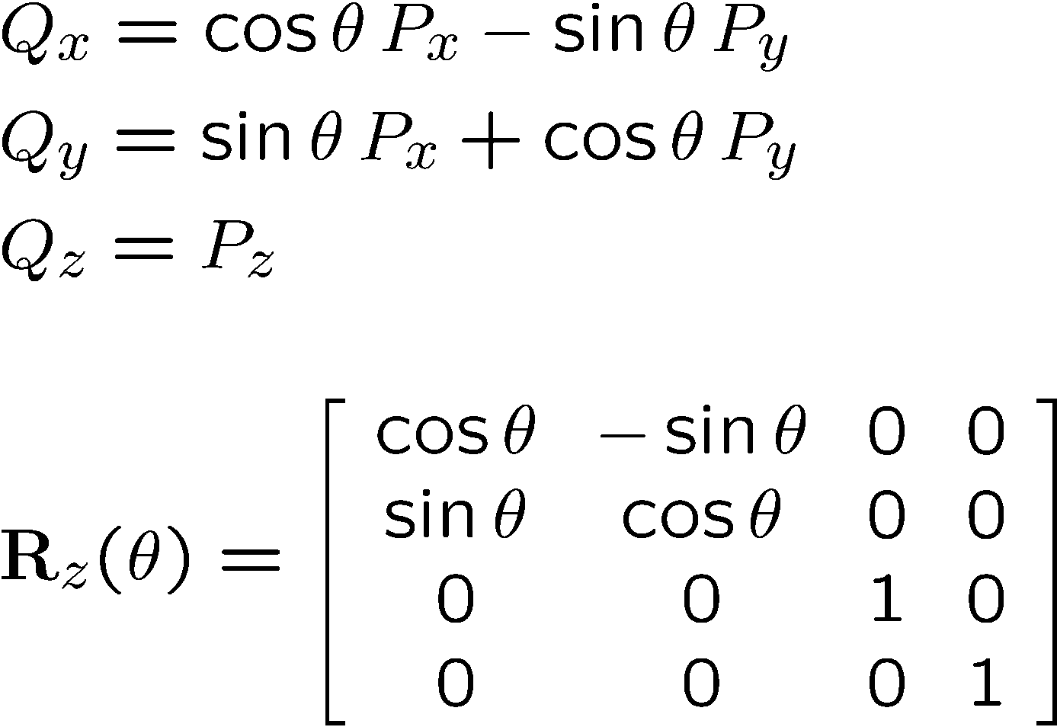
Z-Roll

Slide 45
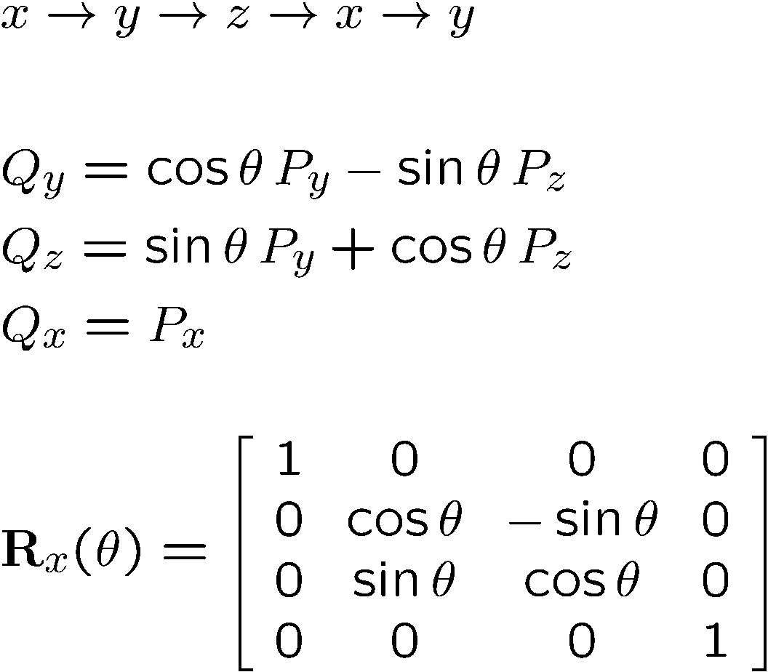
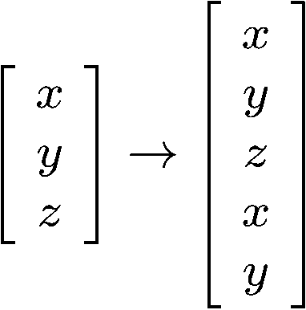
X-Roll
Cyclic indexing

Slide 46
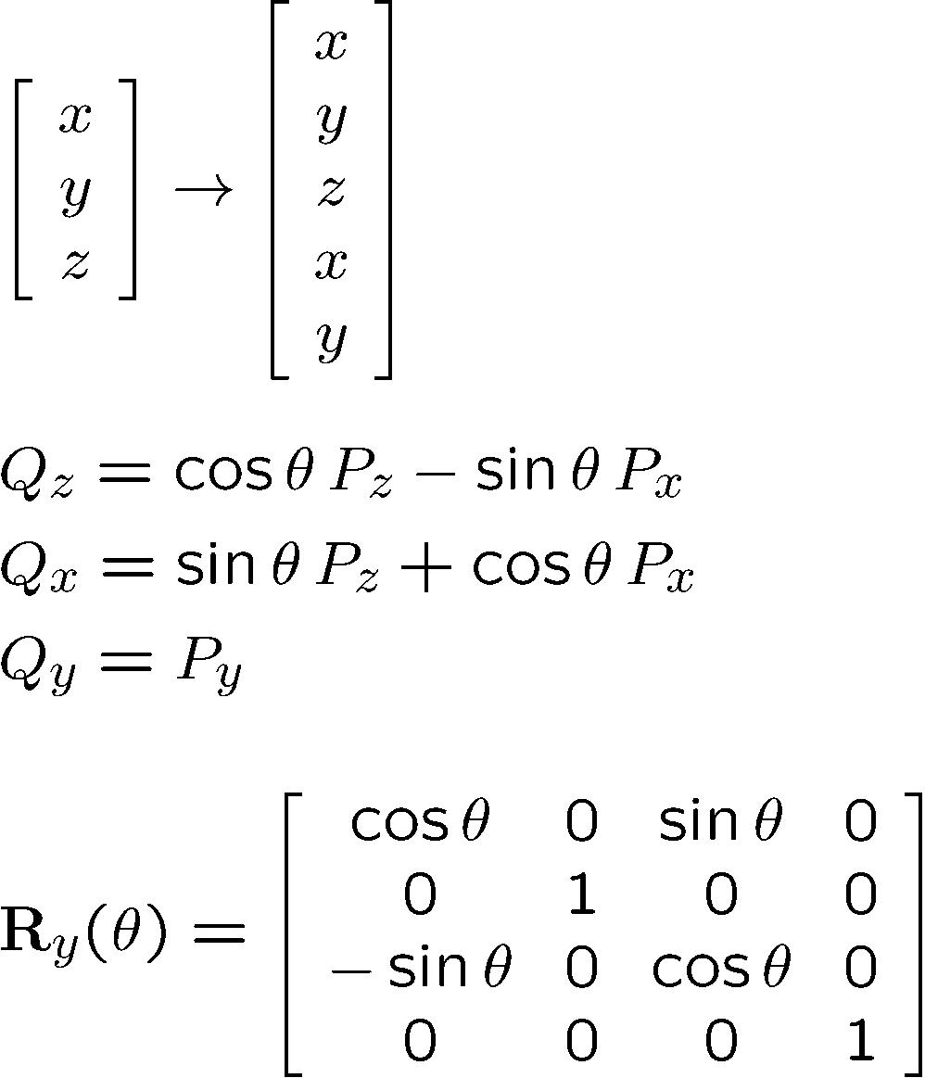
Y-Roll

Slide 47
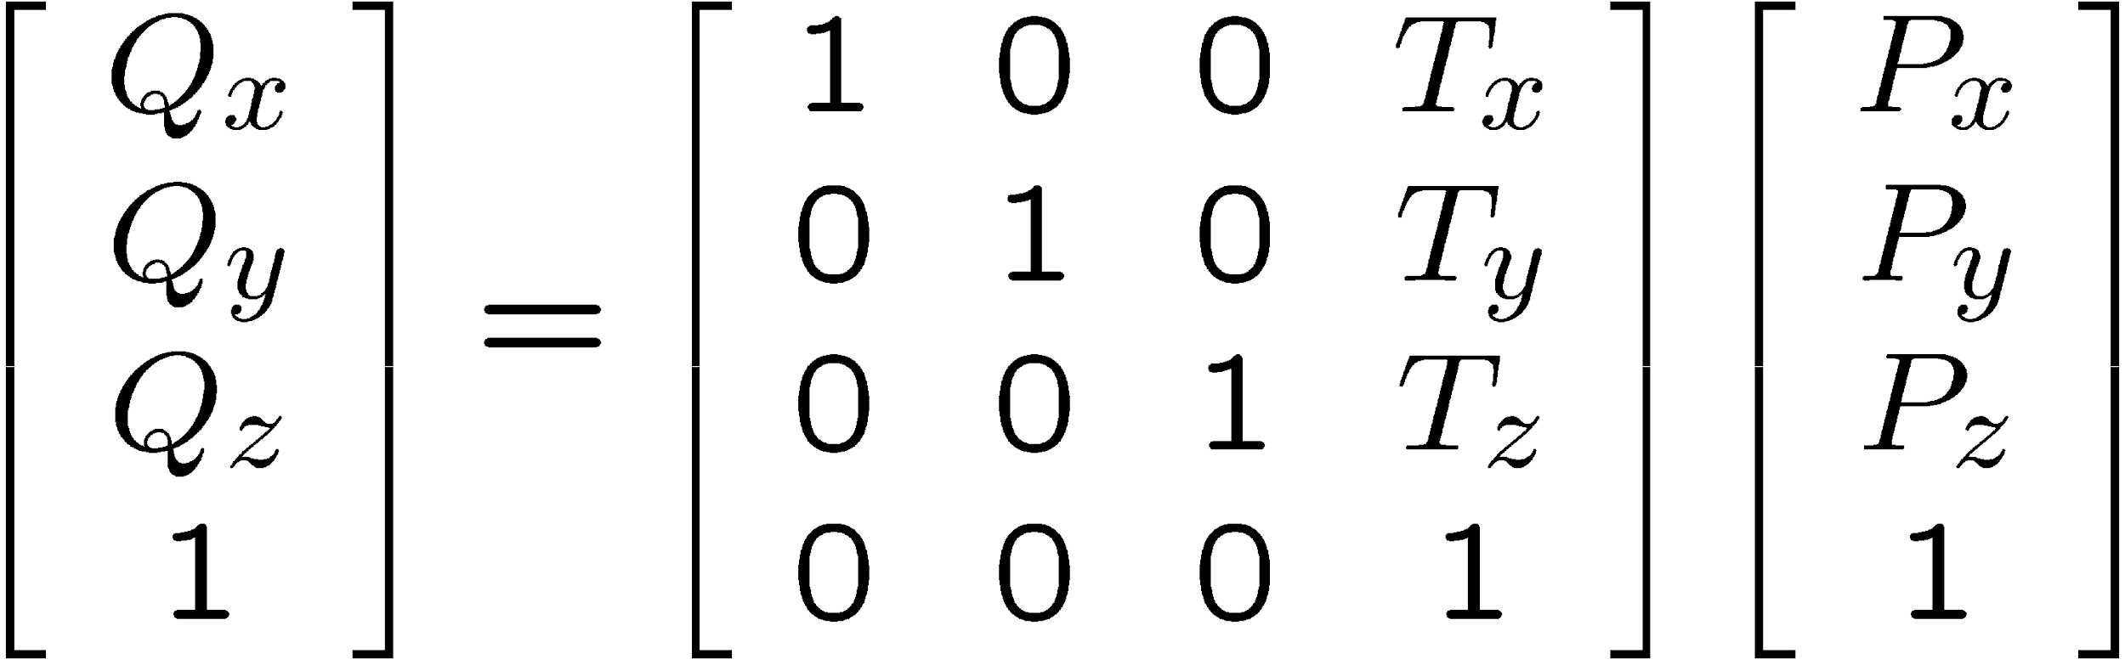
Elementary 3D Affine Transformations
Translation

Slide 48
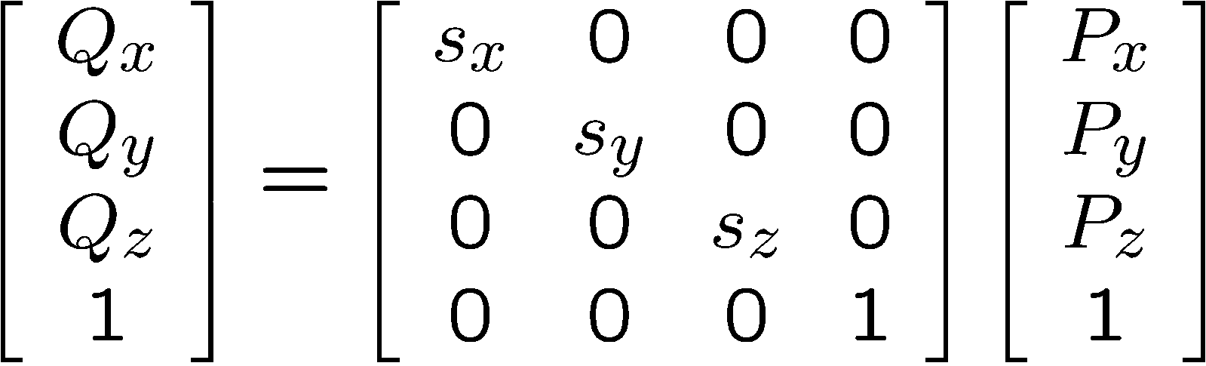
Scaling Around the Origin

Slide 49
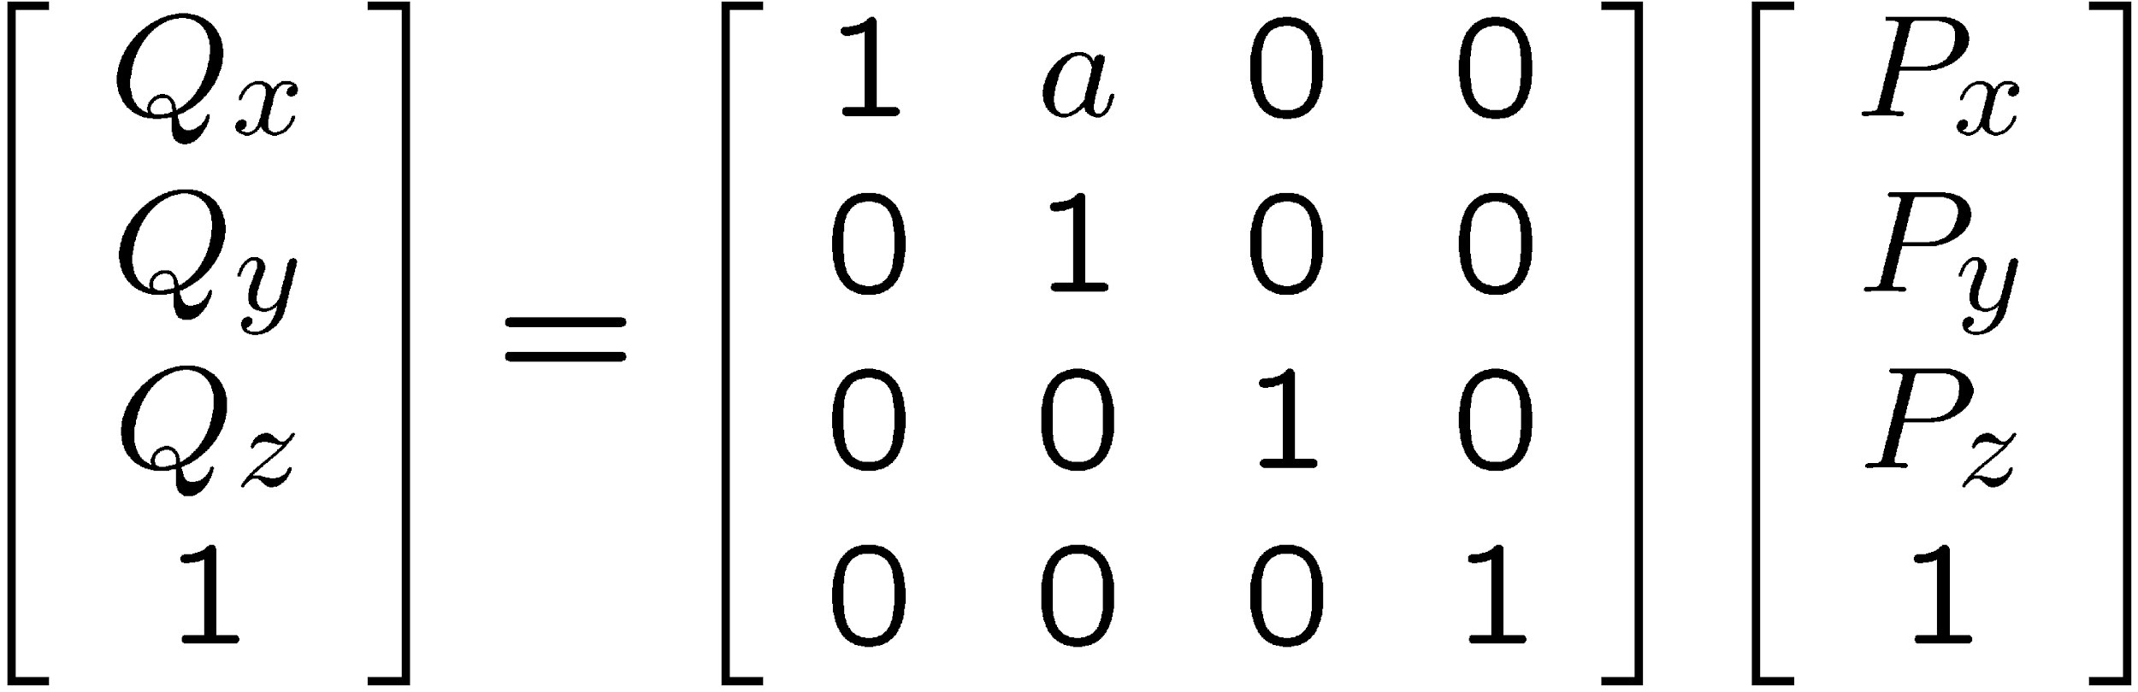
Shear Around the Origin
Along x-axis

Slide 50
Inverse of a Transformation
Inverse transformation: Q = MP, P = M⁻¹Q
We can use Cramer’s rule to invert M, or we can be smarter about it
M
Q
P
M⁻¹

Slide 51
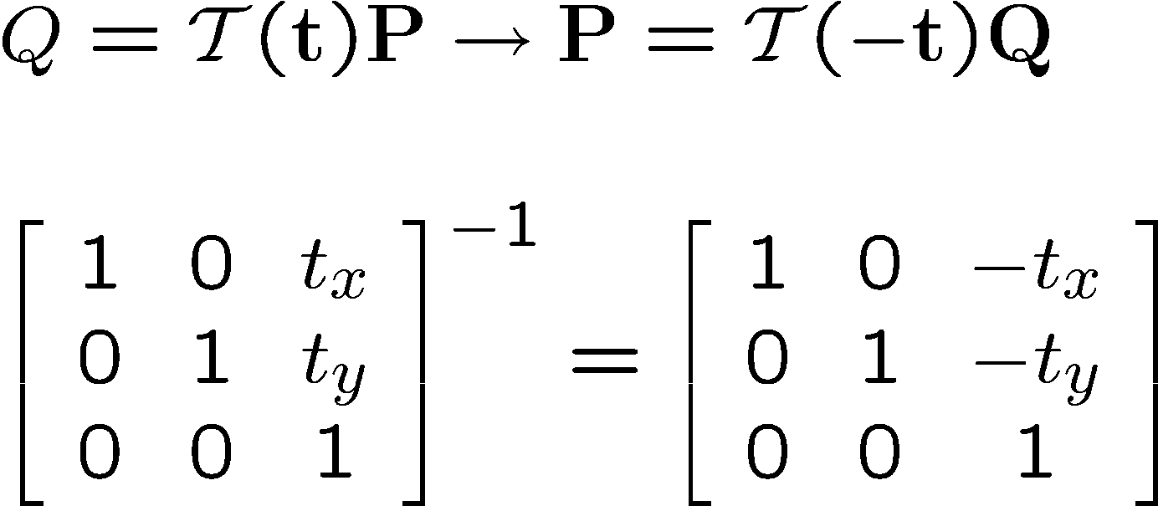
Inverse of Translation

Slide 52
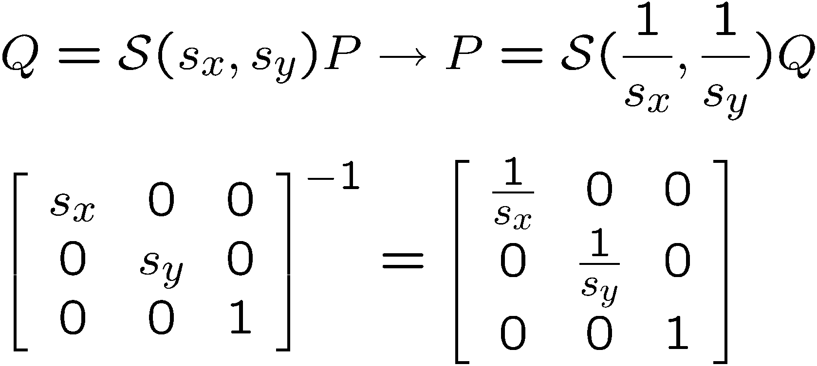
Inverse of Scaling

Slide 53
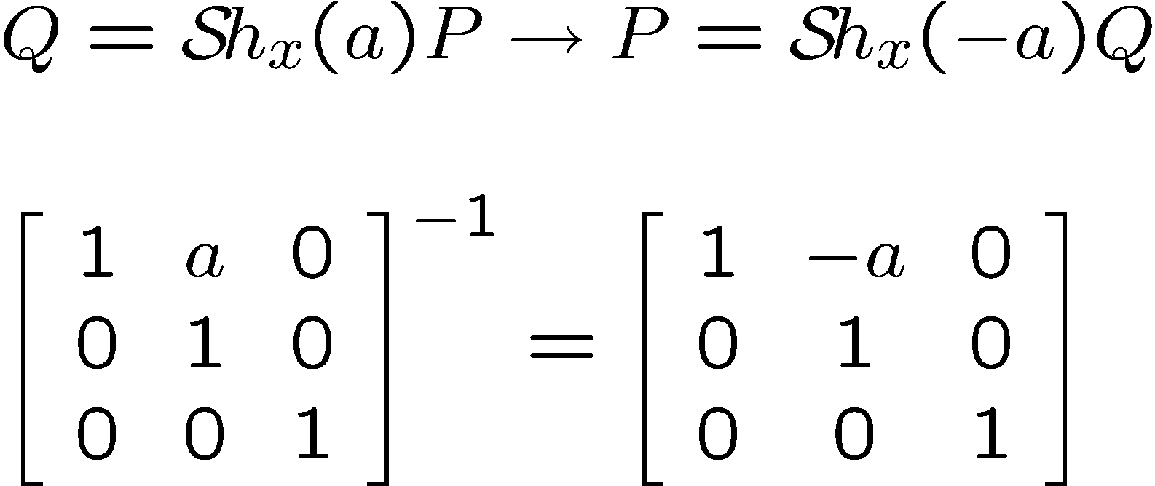
Inverse of a Shear in x

Slide 54
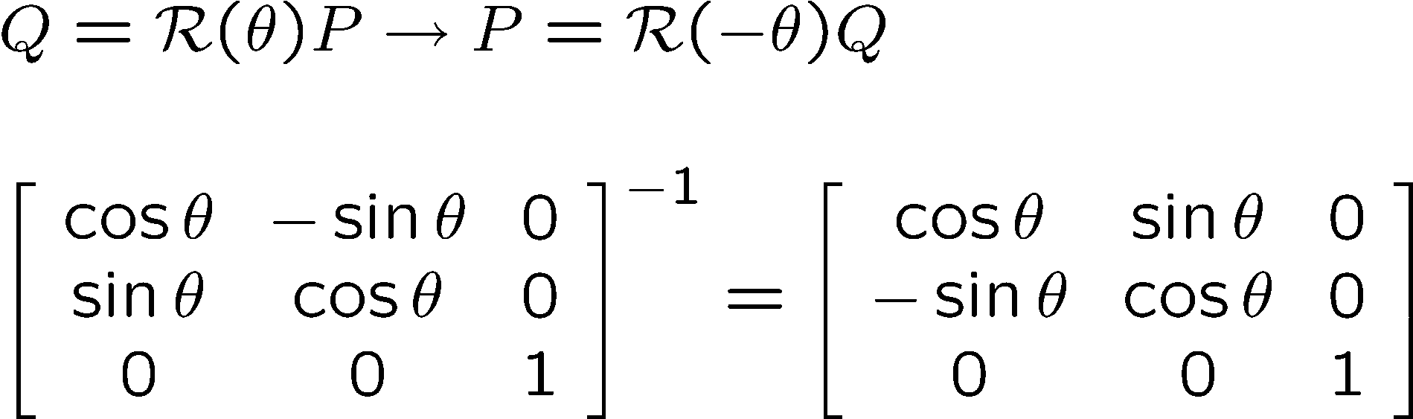
Inverse of Rotation

Slide 55
Inversion of Transformations
Translation: T⁻¹(t_{x},t_{y},t_{z}) = T(-t_{x},-t_{y},-t_{z})
Rotation: R⁻¹_{axis}(θ) = R_{axis}(-θ)
Scaling: S⁻¹(s_{x},s_{y},s_{z}) = S(1/s_{x},1/s_{y},1/s_{z})
Shearing: Sh⁻¹(a) = Sh(-a)

Slide 56
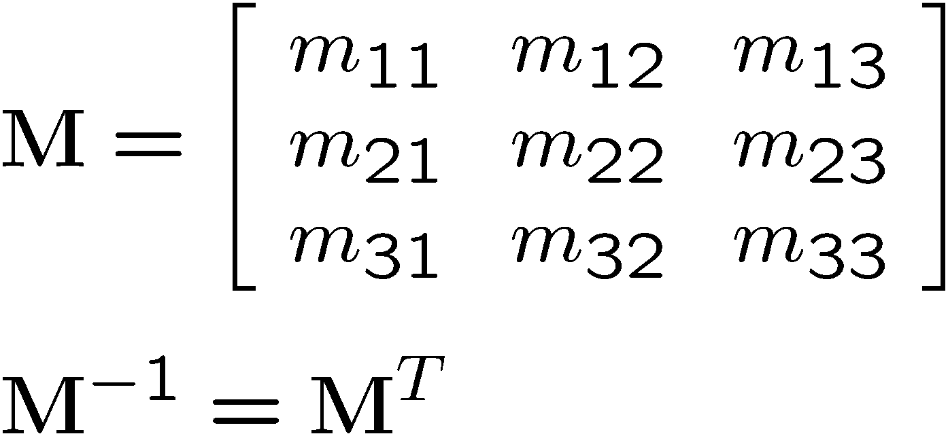
Inverse of Rotations
Pure rotation only, no scaling nor shear
Since the rotation matrix M is an orthonormal matrix

Slide 57
Composition of 3D Affine Transformations
The composition of affine transformations is an affine transformation
Any 3D affine transformation can be performed as a series of elementary affine transformations

